Slide 1
Create
Dashboards
Create
Dashboards

Slide 2
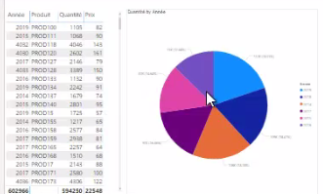
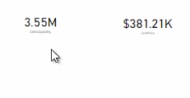
Creating Dashboards
Note: This lab requires a Power BI Services account with administrator privileges.
Start by uploading the SalesExcel.xlsx file as a DataSet to Power BI Service .
Load the DataSet into the report editor at the Power BI Services level .
Add visuals to create two test reports from this DataSet .

Slide 3

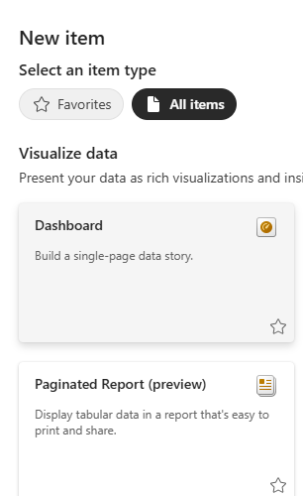
Creating Dashboards
Save both reports to the workspace.
Click the button at the workspace level, then select Dashboard .

Slide 4
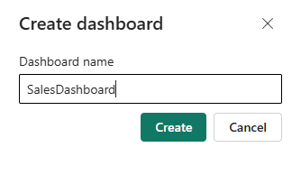
Creating Dashboards
Name the Dashboard .

Slide 5
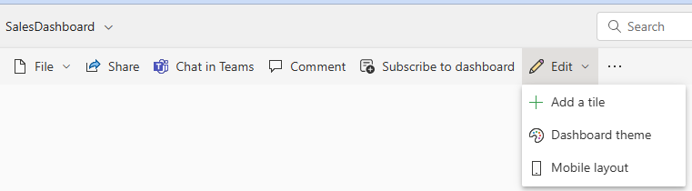
Creating Dashboards
Click Edit , then Add a tile .

Slide 6
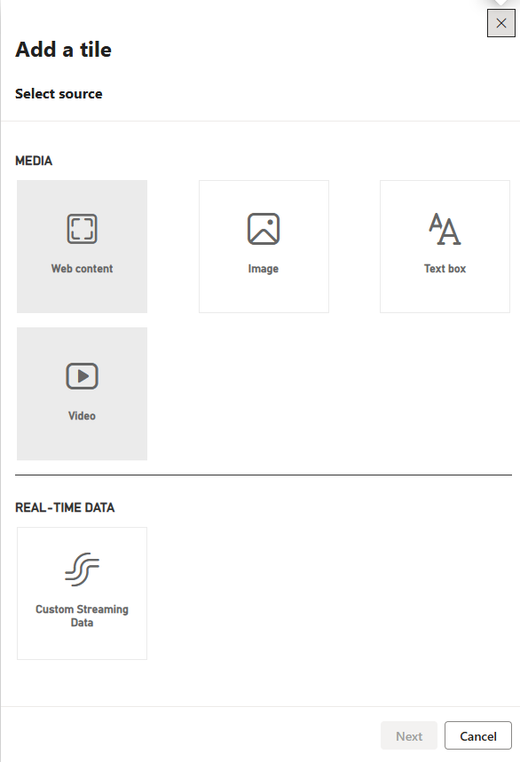
Creating Dashboards
Explore the items that can be added to the Dashboard .

Slide 7
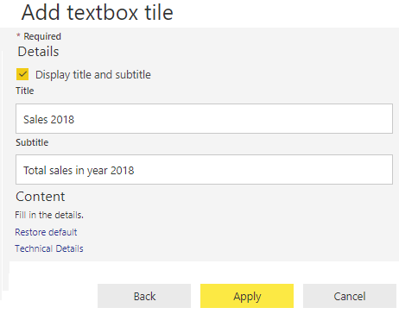
Creating Dashboards
Add a Text box element to insert a title.

Slide 8
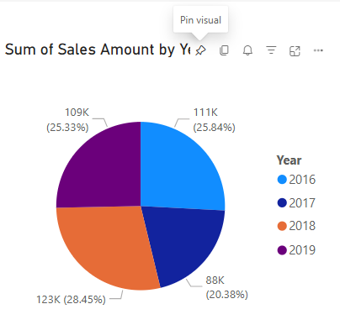
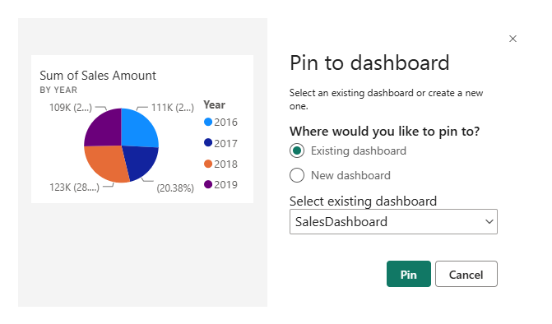
Creating Dashboards
To return to one of the reports and select a visual, click the Pin the visual icon .
Existing Visual radio button , then choose the previously created Dashboard from the Select existing drop-down list dashboard .

Slide 9
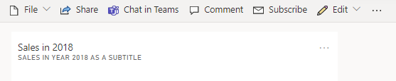
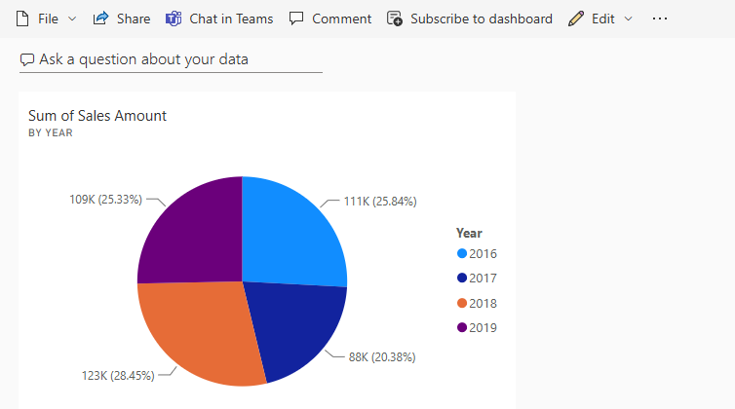
Creating Dashboards
Continue adding visuals from several other reports.
Navigate through the menu visible at the top of the screen.
Before
After

Slide 10
Thank you
Thank you

